Slide 1
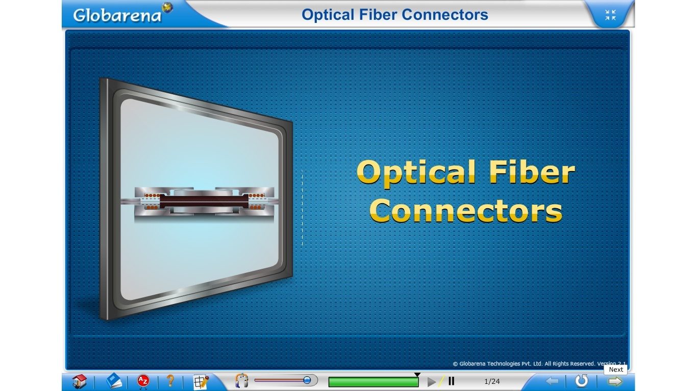

Slide 2
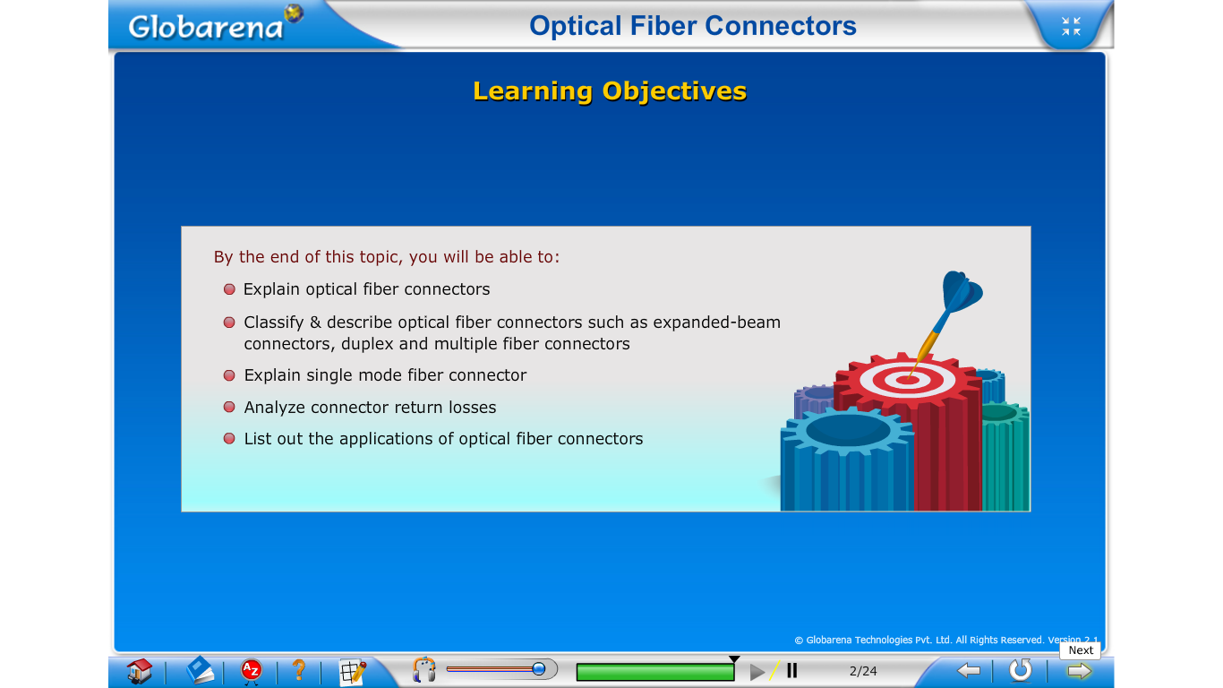

Slide 3
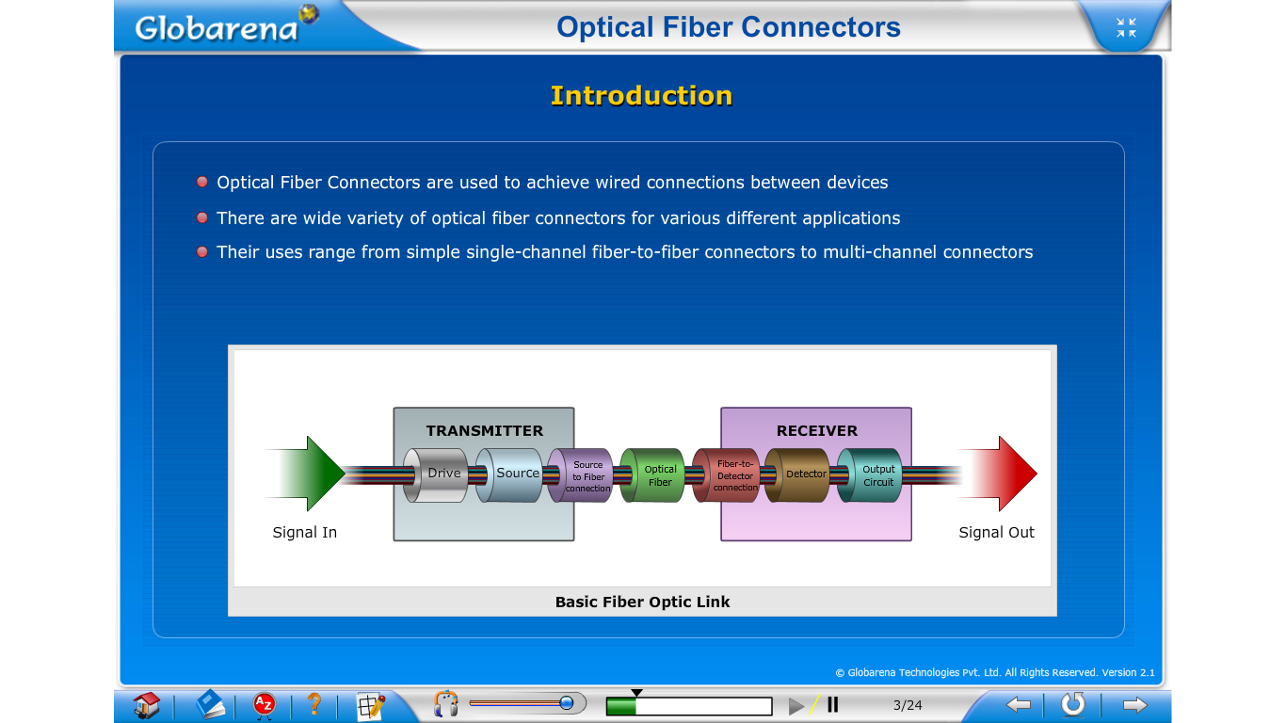

Slide 4
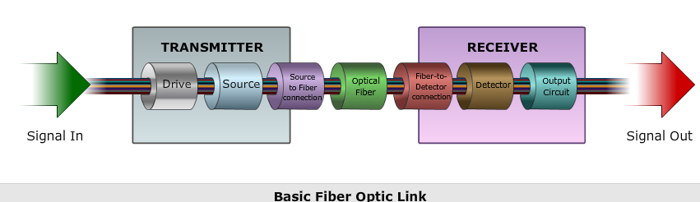
Used in harsh military field environments.

Slide 5
Optical Fiber Connectors
A wide variety of optical fiber connectors has evolved for numerous different applications.
Their uses range from simple single-channel fiber-to-fiber connectors in a benign location to multichannel connectors used in harsh military field environments.

Slide 6
Some of the principal requirements of a good connector design are as follows
1. Low coupling Losses: The connector assembly must maintain stringent alignment tolerances to assure low mating losses. These low losses must not change significantly during operation and after numerous connects and disconnects.
2. Interchangeability: Connectors of the same type must be compatible from one manufacturer to another.
3. Ease of assembly: A service technician should be able to install the connector easily in a field environment, that is, in a location other than the connector factory. The connector loss should also be fairly insensitive to the assembly skill of the technician.
4. low environmental sensitivity: Conditions such as temperature, dust, and moisture should have a small effect on connector-loss variations.
5. Low-cost and reliable construction: The connector must have a precision suitable to the application, but its cost must not be a major factor in the fiber system.
6. Ease of connection: Generally one should be able to mate and demate the connector, simply, by hand.

Slide 7



Slide 8
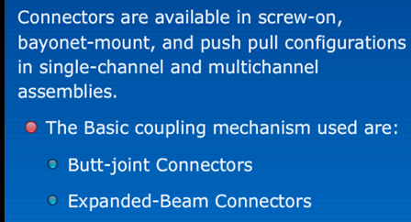
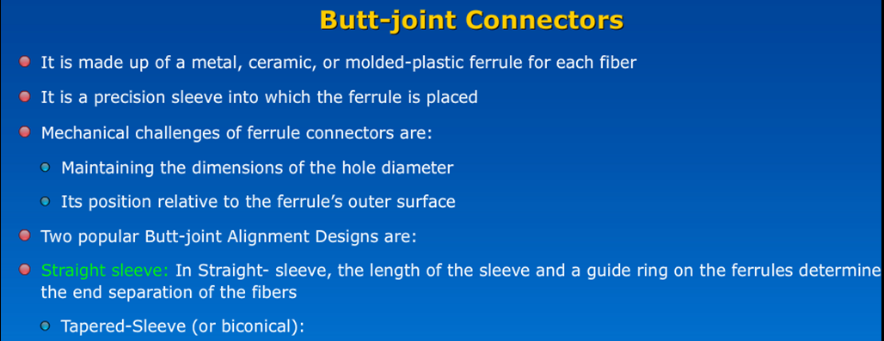





Slide 9
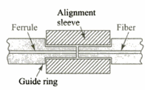
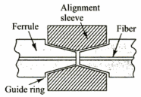

Slide 10

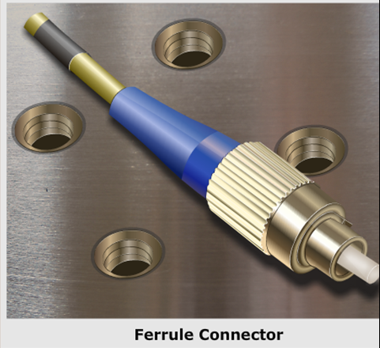
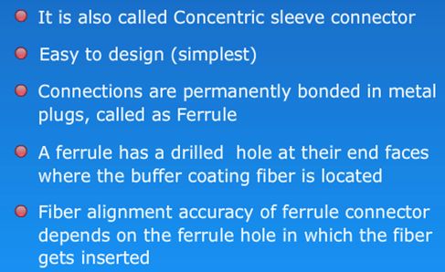

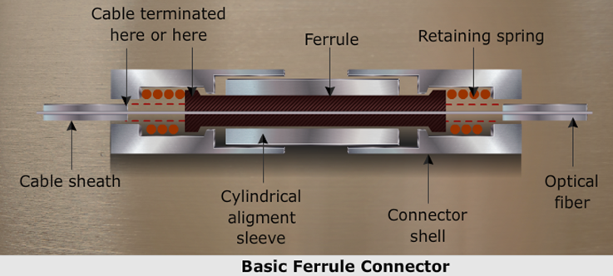

Slide 11

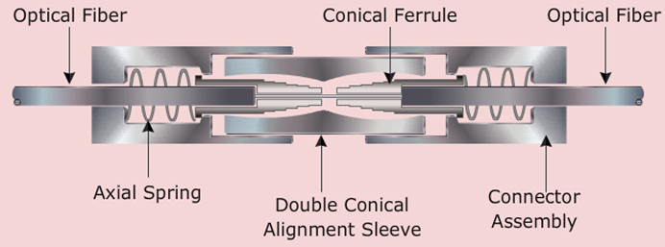

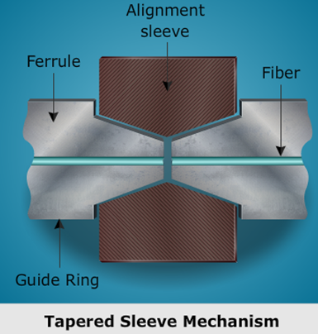

Slide 12

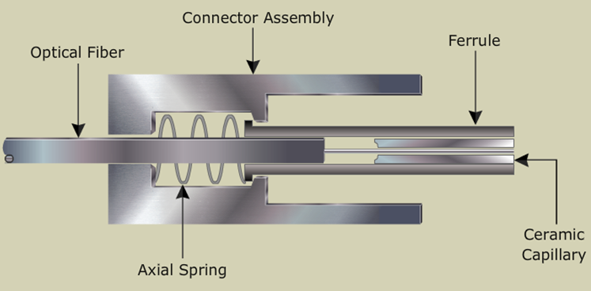
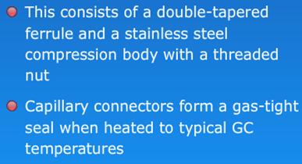
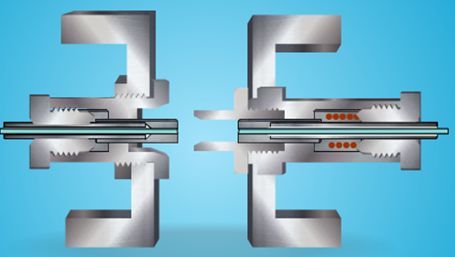
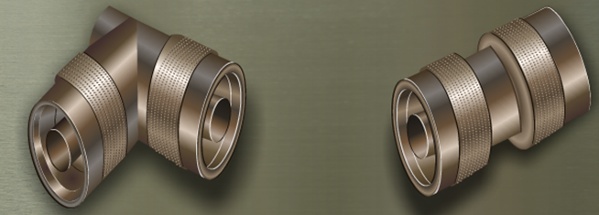

Slide 13

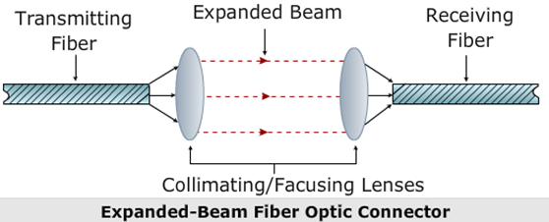
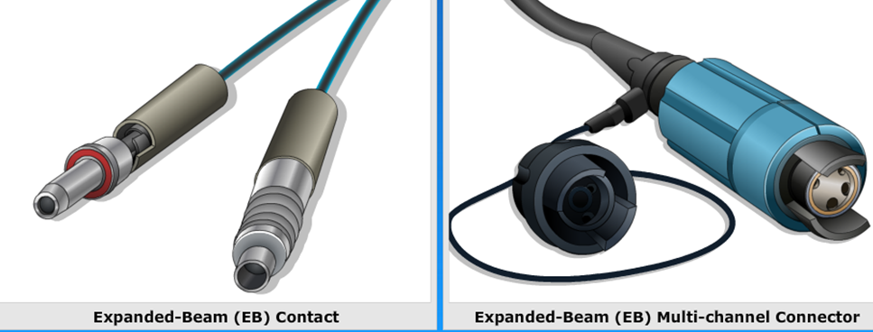

Slide 14
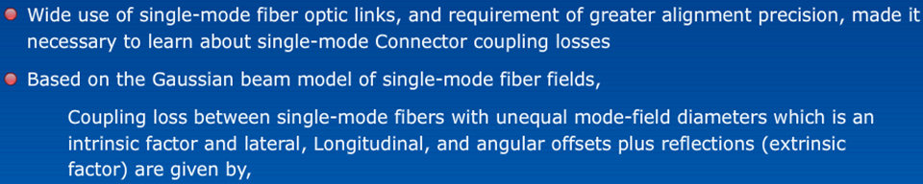
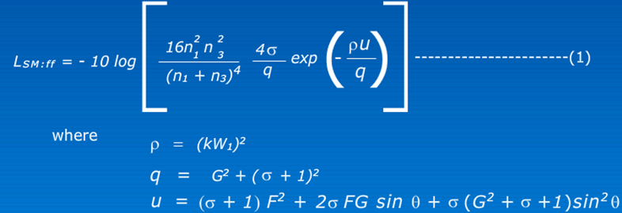
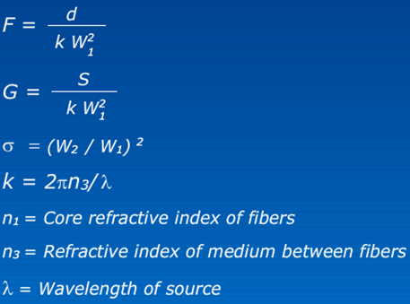
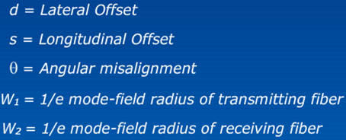

Slide 15


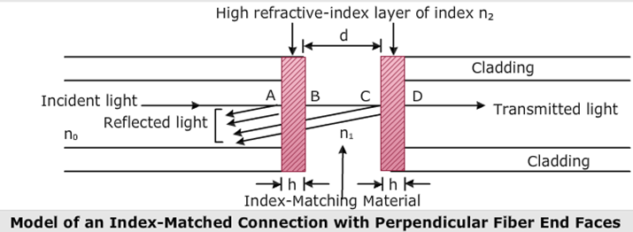
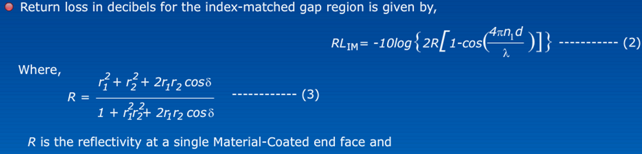

Slide 16
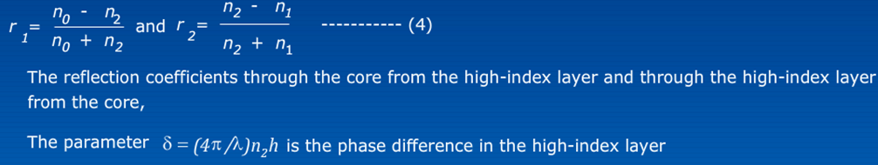
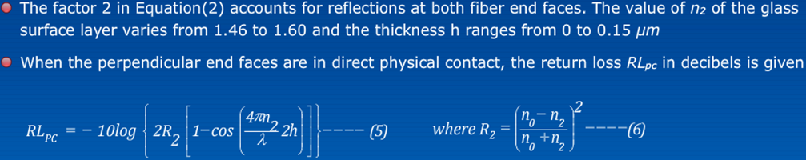
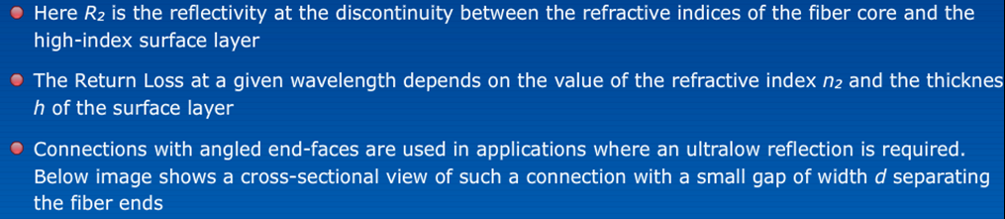

Slide 17
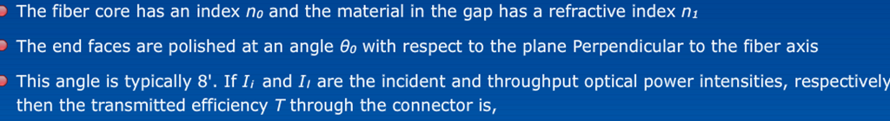
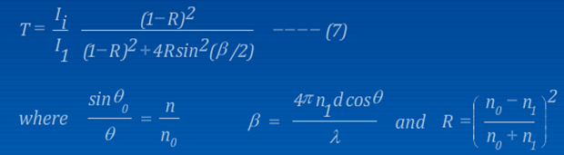
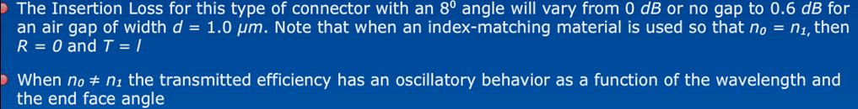

Slide 18

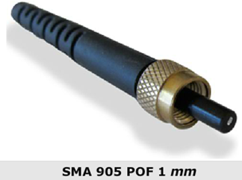

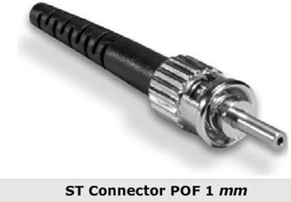

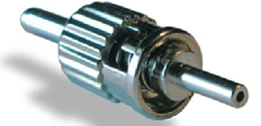

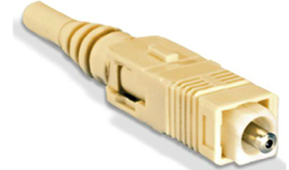


Slide 19

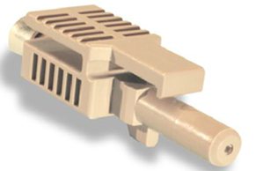
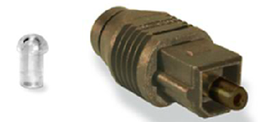

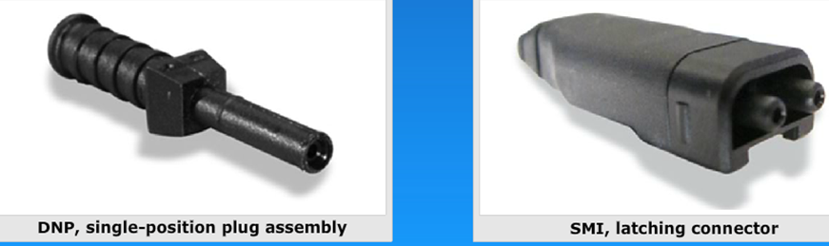

Slide 20
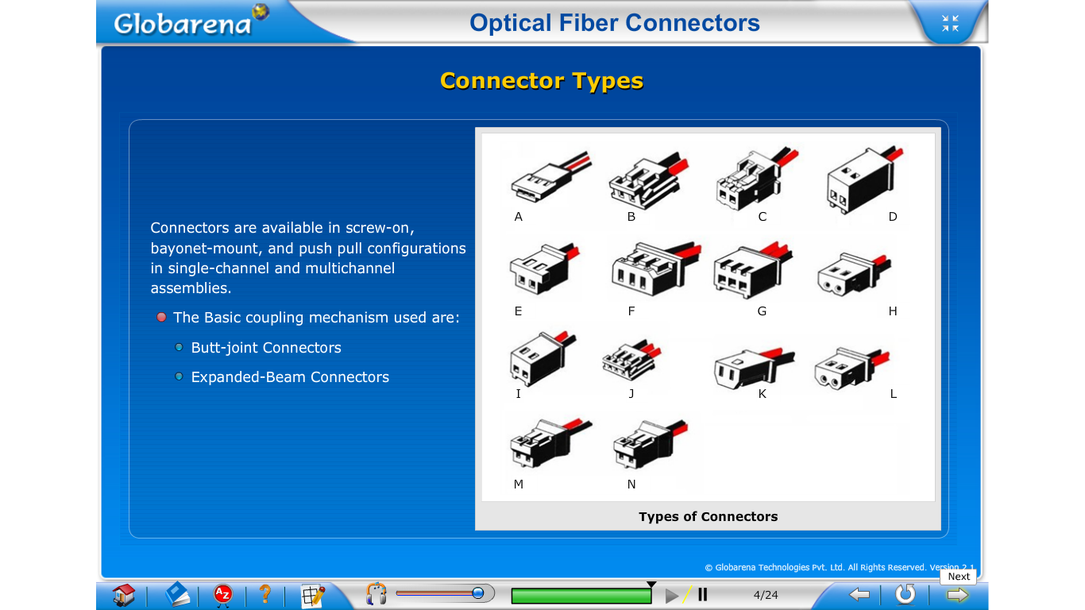

Slide 21
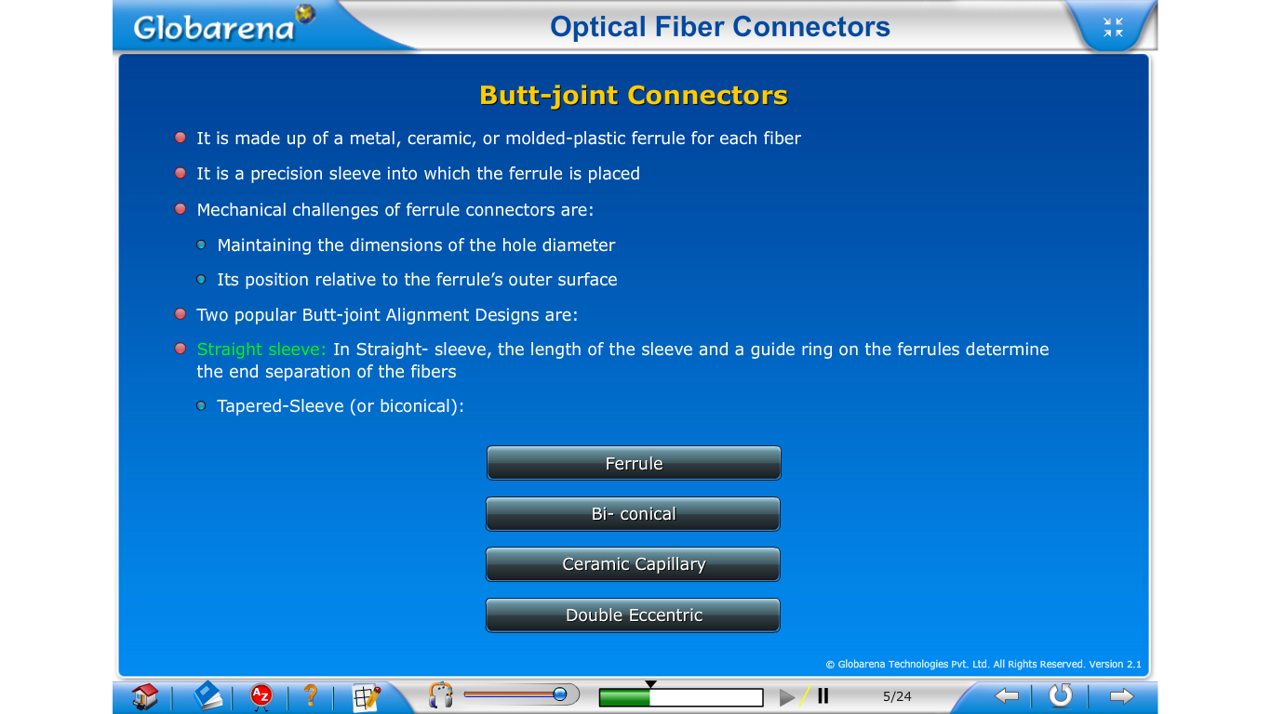

Slide 22
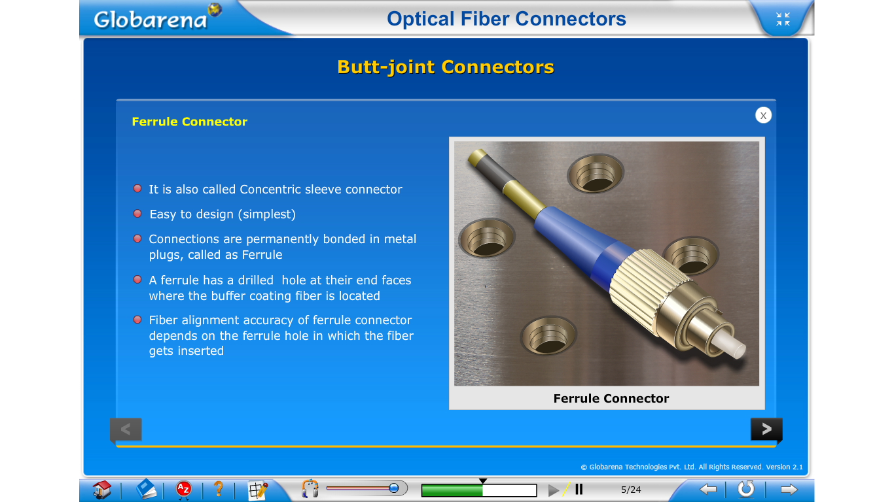

Slide 23
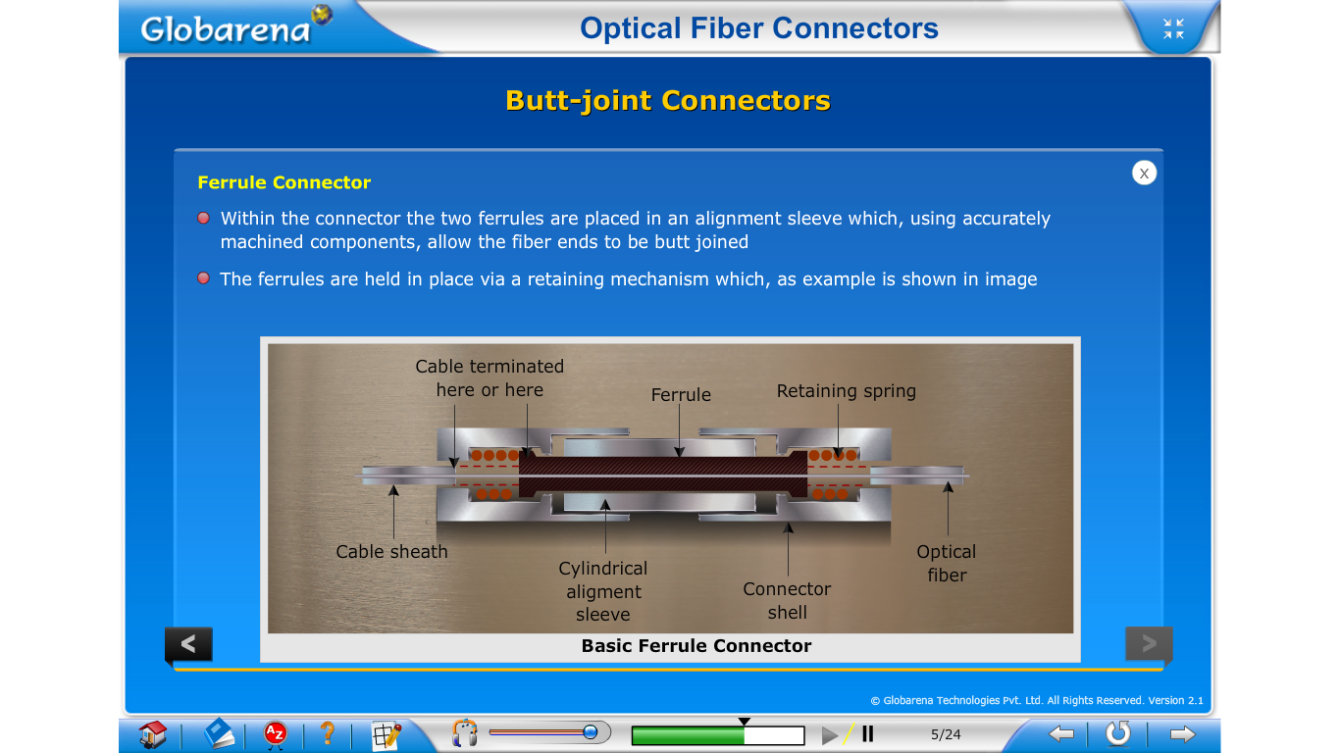

Slide 24
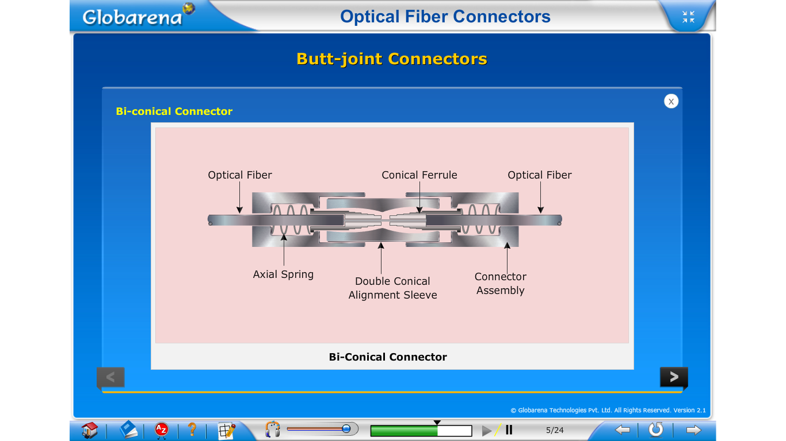

Slide 25
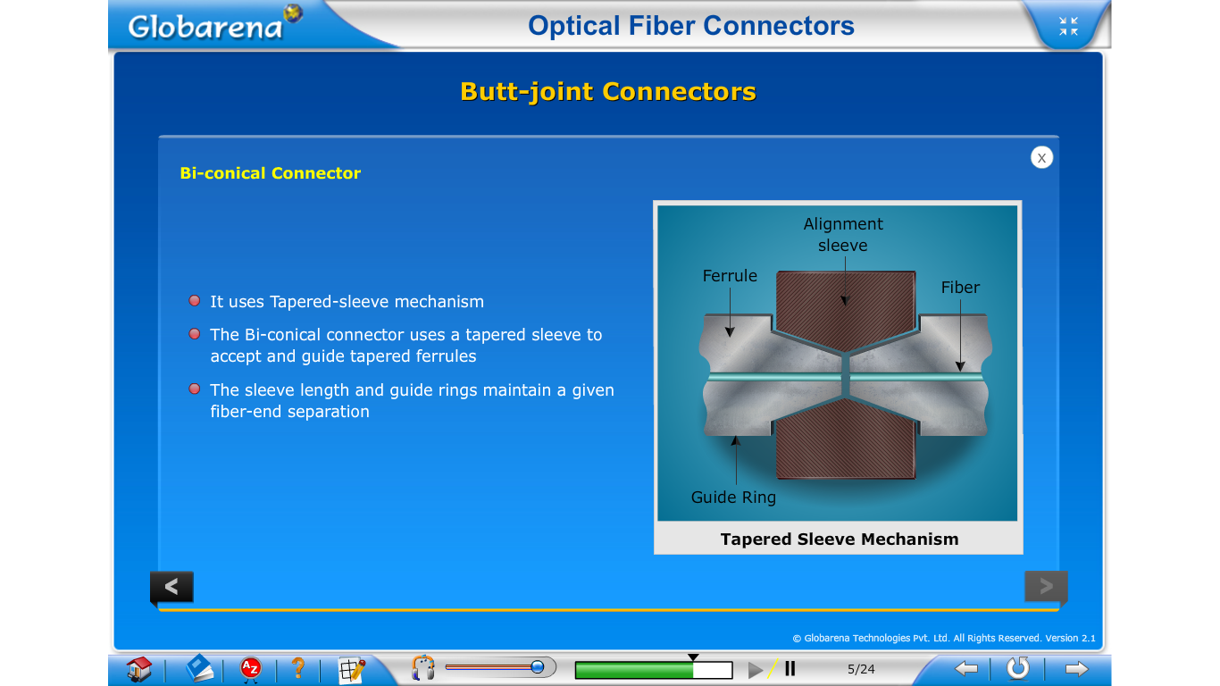

Slide 26
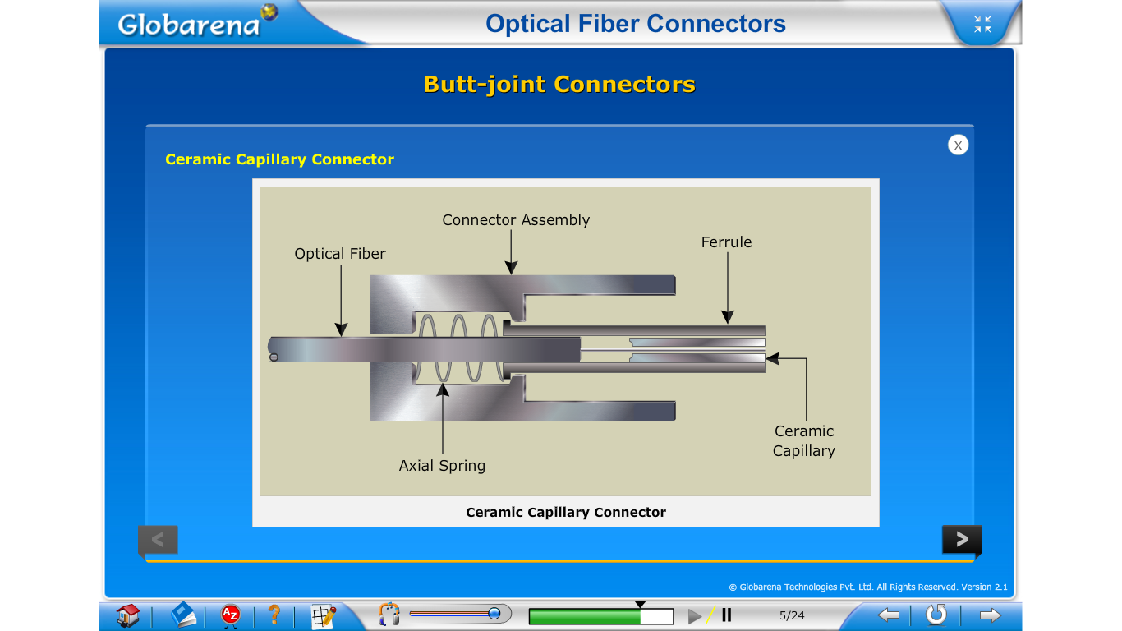

Slide 27
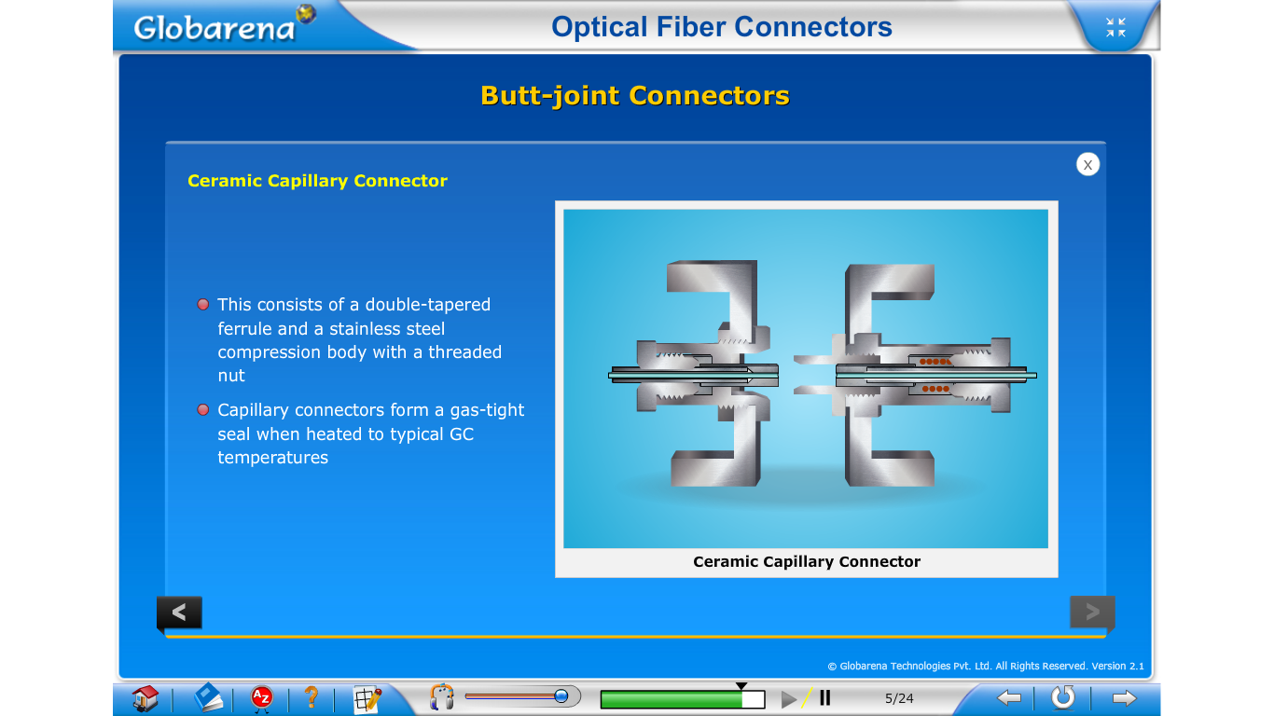

Slide 28
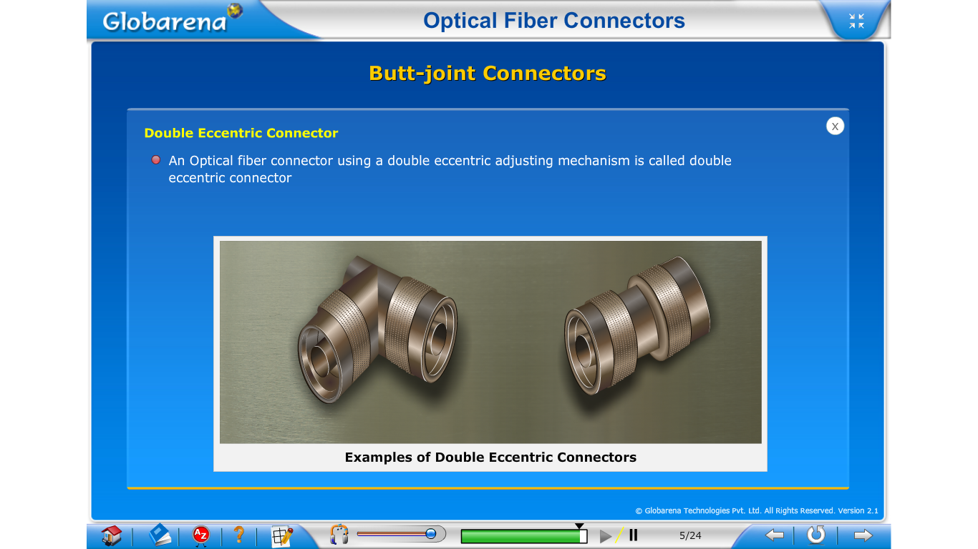

Slide 29
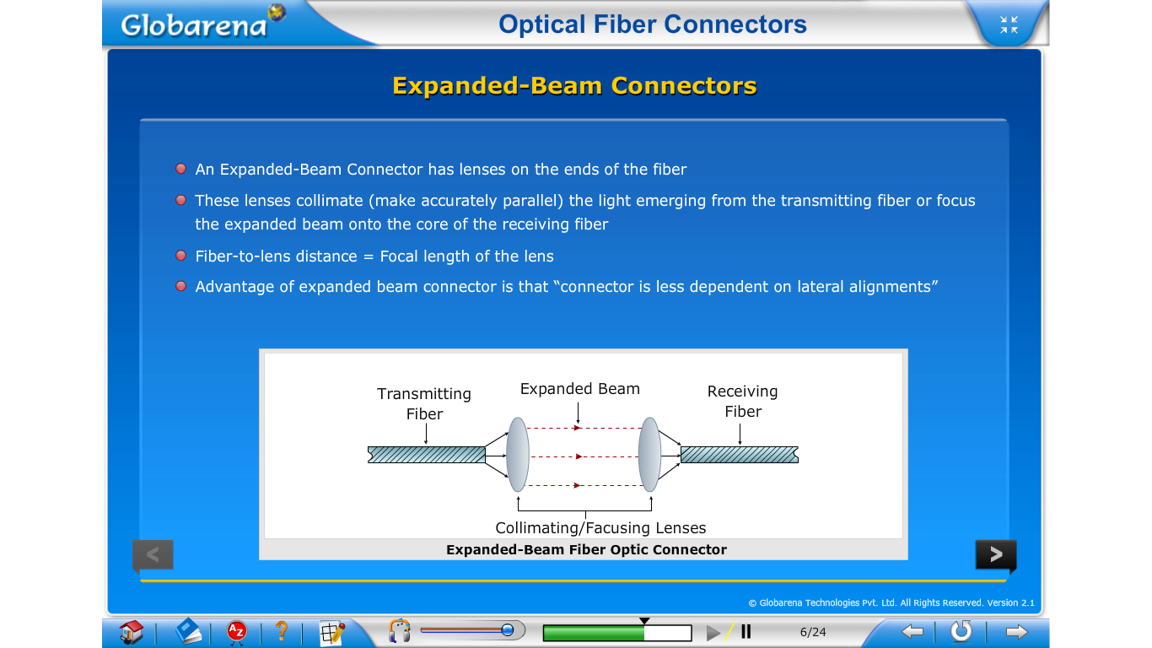

Slide 30
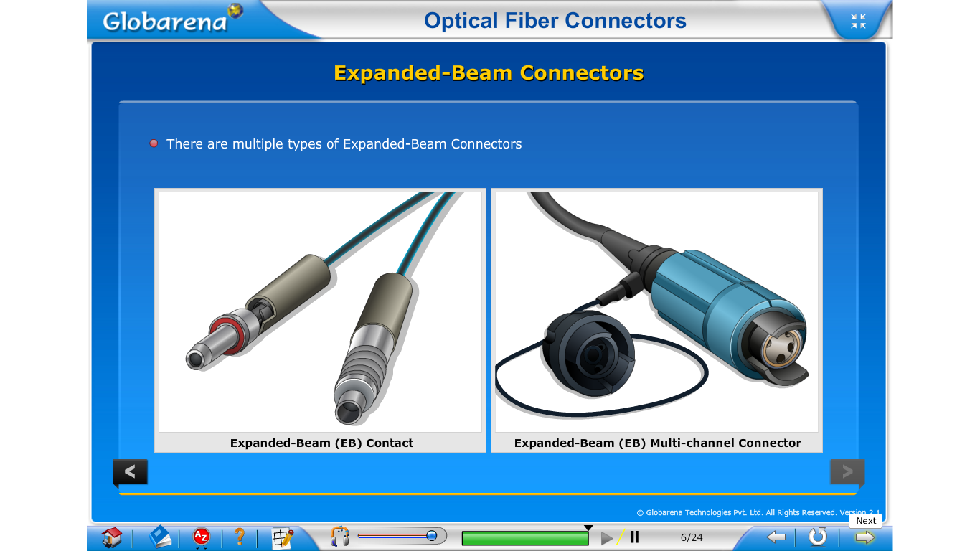

Slide 31
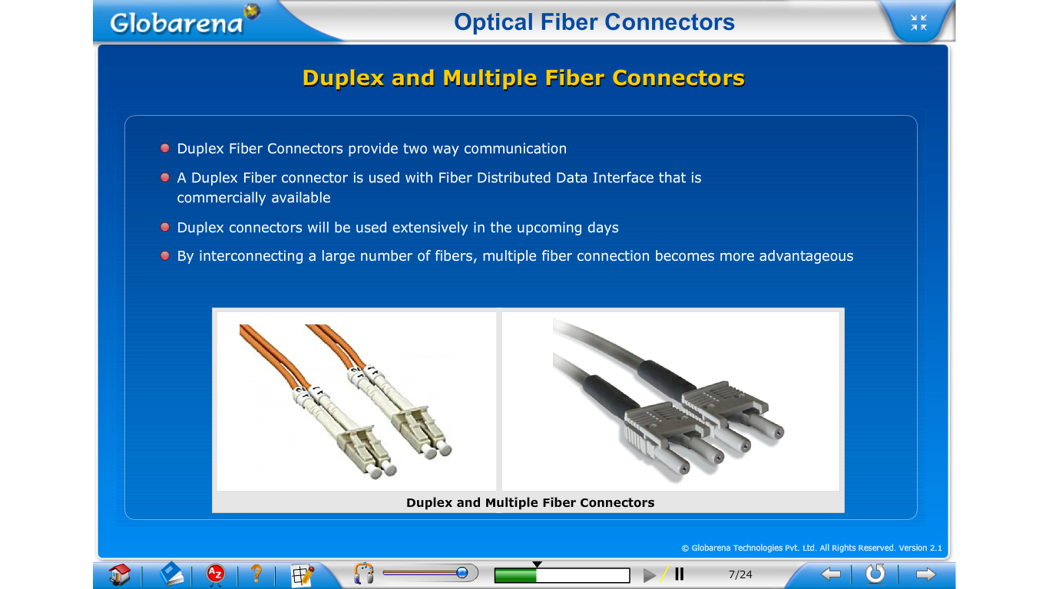

Slide 32


Slide 33


Slide 34


Slide 35


Slide 36


Slide 37


Slide 38


Slide 39


Slide 40


Slide 41


Slide 42


Slide 43


Slide 44


Slide 45


Slide 46


Slide 47


Slide 48


Slide 49


Slide 50


Slide 51


Slide 52


Slide 53


Slide 54


Slide 55


Slide 56


Slide 57


Slide 58


Slide 59


Slide 60


Slide 61


Slide 62


Slide 63


Slide 64


Slide 65


Slide 66


Slide 67


Slide 68


Slide 69


Slide 70


Slide 71


Slide 72


Slide 73


Slide 74


Slide 75


Slide 76


Slide 77



Slide 78


Slide 79


Slide 80


Slide 81


Slide 82


Slide 83


Slide 84


Slide 85


Slide 86


Slide 87


Slide 88


Slide 89


Slide 90


Slide 91


Slide 92


Slide 93


Slide 94


Slide 95


Slide 96


Slide 97


Slide 98


Slide 99


Slide 100


Slide 101


Slide 102


Slide 103


Slide 104


Slide 105


Slide 106


Slide 107


Slide 108


Slide 109


Slide 110


Slide 111


Slide 112


Slide 113


Slide 114


Slide 115


Slide 116


Slide 117


Slide 118


Slide 119


Slide 120


Slide 121


Slide 122


Slide 123


Slide 124


Slide 125


Slide 126


Slide 127


Slide 128


Slide 129


Slide 130


Slide 131


Slide 132


Slide 133


Slide 134


Slide 135


Slide 136


Slide 137


Slide 138


Slide 139


Slide 140


Slide 141


Slide 142
Completed

Slide 145
FIBER SPLICING-Keiser
A fiber splice is a permanent or semi-permanent joint formed between two individual optical fibers.
These are typically used to create long-haul optical fiber links or in situations where frequent connection and disconnection are not needed.
In making and evaluating such splices, one must take into account the geometrical differences in the two fibers, fiber misalignments at the joint, and the mechanical strength of the splice.
Splices may be divided into two broad categories depending upon the splicing technique utilized.
These are fusion splicing or welding and mechanical splicing.

Slide 146
Splicing Techniques
Fusion splicing techniques include the Fusion splice, the V-groove mechanical splice, and the elastic-tube splice.
The first technique yields a permanent joint, whereas other two types of splices can be disassembled if necessary.
Fusion splices are made by thermally bonding together prepared fiber ends, as pictured in Fig.5.17 .
In this method, the fiber ends are first prealigned and butted together.
This is done either in a grooved fiber holder or under a microscope with micromanipulators.
The butt joint is then heated with an electric arc or a laser pulse so that the fiber ends are momentarily melted and hence bonded together.
This technique can produce very low splice losses, which typically are in the range of 0.05 to 0.10 dB for both single-mode and multimode fibers.

Slide 147


Slide 148
However, care must be exercised in this technique, since bubbles arising from dirt or fiber coating particles that are trapped and gasified in the splice, incorrectly set fusion are current, application of insufficient heat, and residual stresses induced near the joint as a result of changes in chemical composition arising from the material melting can produce a weak splice.
In the V-groove splice technique, the prepared fiber ends are first butted together in a V-shaped groove, as shown in Fig.5-18.
They are then bonded together with an adhesive or are held in place by means of a cover plate.
The V-shaped channel could be either a grooved silicon, plastic, ceramic, or metal substrate.
The splice loss in this method depends strongly on the fiber size (outside dimensions and core diameter variations) and eccentricity (the position of the core relative to the center of the fiber).

Slide 149


Slide 150
The elastic-tube splice shown cross-sectionally in Fig. 5-19 is a unique device that automatically performs lateral, longitudinal, and angular alignment.
It splices multimode fibers with losses in the same range as commercial fusion splices, but much less equipment and skill are needed.
The splice mechanism is basically a tube made of an elastic material.

Slide 151


Slide 152
The central hole diameter is slightly smaller than that of the fiber to be spliced and is tapered on each end for easy fiber insertion.
When a fiber is inserted, it expands the hole diameter so that the elastic material exerts a symmetrical force on the fiber.
This symmetry feature allows an accurate and automatic alignment of the axes of the two fibers to be joined.
A wide range of fiber diameters can be inserted into the elastic tube.
Thus, the fibers to be spliced do not have to be equal in diameter, since each fiber moves into position independently relative to the tube axis.

Slide 153

Splicing Single-Mode Fibers
As is the case multimode fibers, in single-mode fibers the lateral(axial) offset loss presents the most serious misalignment.
This loss depends on the shape of the propagating mode.
For Gaussian-shaped beams the loss between identical fiber is
Where the spot size W is the mode-field radius and d is the lateral displacement shown in Fig.5.9.
Since the spot size is only a few micrometers in single-mode fibers, low-loss coupling requires a very high degree of mechanical precision in the axial dimension.

Slide 154


Slide 155


For angular misalignment in single-mode fibers, the loss at a wavelength λ is
Where n2 is the refractive index of cladding, θ is the angular misalignment in radians shown Fig.5.9 and w is the mode-field radius.
For a gap s (Longitudinal distance/ end separation) with a material of index n3, and letting G= s / kw2 , the gap loss for identical single-mode fiber splices is

Slide 156
OPTICAL FIBER CONNECTORS
A wide variety of optical fiber connectors has evolved for numerous different applications.
Their uses range from simple single-channel fiber-to-fiber connectors in a benign location to multichannel connectors used in harsh military field environments.
Some of the principal requirements of a good connector design are as follows.
1. Low coupling Losses: The connector assembly must maintain stringent alignment tolerances to assure low mating losses. These low losses must not change significantly during operation and after numerous connects and disconnects.
2. Interchangeability: Connectors of the same type must be compatible from one manufacturer to another.

Slide 157
3. Ease of assembly: A service technician should be able to install the connector easily in a field environment, that is, in a location other than the connector factory. The connector loss should also be fairly insensitive to the assembly skill of the technician.
4. low environmental sensitivity: Conditions such as temperature, dust, and moisture should have a small effect on connector-loss variations.
5. Low-cost and reliable construction: The connector must have a precision suitable to the application, but its cost must not be a major factor in the fiber system.
6. Ease of connection: Generally one should be able to mate and demate the connector, simply, by hand.

Slide 159
Connector Types-Keiser2
Connectors are available in designs that screw on, twist on, or snap into place.
The most commonly used connectors are the twist-on and snap-on design.
These include both single-channel and multichannel assemblies for cable-to-cable and for cable-to-circuit card connections.
The basic coupling mechanisms used in these connectors belong to either the Butt-joint or the Expanded-beam classes.

Slide 160
The majority of connectors today are of the Butt-joint type.
These connectors employ a metal, ceramic, or molded-plastic ferrule for each fiber and precision sleeve into which the ferrule fits.
The fiber is epoxied into a precision hole which has been drilled into the ferrule.
The mechanical challenges of ferrule connectors include maintaining both the dimensions of the hole diameter and its position relative to the ferrule outer surface.

Slide 161
Figure 5.20 shows two popular Butt-joint alignment designs used in both multimode and single-mode fiber systems.
These are the Straight-sleeve and the Tapered-sleeve (or Biconical) mechanisms.
In the straight-sleeve connector the length of the sleeve and a guide ring on the ferrules determine the end separation of the fibers.
The biconical connector uses a tapered sleeve to accept and guide tapered ferrules.
Again the sleeve length and the guide rings maintain a given fiber end separation.

Slide 162
An expanded-beam connector, illustrated in Fig. 5-21, employs lenses on the ends of the fibers.
These lenses either collimate the light emerging from the transmitting fiber, or focus the expanded beam onto the core of the receiving fiber.
The fiber-to-lens distance is equal to the focal length of the lens.
The advantage of this scheme is that, since the beam is collimated, separation of the fiber ends may take place within the connector.
Thus the connector is less dependent on lateral alignments.
In addition, optical processing elements, such as beam splitters and switches, can easily be inserted into the expanded beam between the fiber ends.

Slide 164
Connector Types
Connectors are available in designs that screw on, twist on, or snap into place.
The most commonly used connectors are the twist-on and snap-on design.
These include both single-channel and multichannel assemblies for cable-to-cable and for cable-to-circuit card connections.
The basic coupling mechanisms used in these connectors belong to either the Butt-joint or the Expanded-beam classes.
Butt-Joined Connectors:
Fiber optic Butt-jointed connectors align and bring the prepared ends of two fibers into close contact.
There are two widely accepted designs of butt-jointed alignment. These are
1) Straight Sleeve Connectors or Cylindrical Ferrule Connectors
2) Biconical Ferrule Connector or Tapered Sleeve Connector

Slide 165
Straight Sleeve Connectors or Cylindrical Ferrule Connectors
The majority of connectors use a Butt-joint coupling mechanism, as illustrated in Fig.
Fig. Example of an alignment (Straight Sleeve Connectors) scheme used in fiber-optic connectors.
The elements shown in the figure are common to most connectors.
The key components are a long, thin stainless steel, glass, ceramic, or plastic cylinder known as a Ferrule and a precision sleeve into which the ferrule fits. This sleeve is known variably as an alignment sleeve, an adapter, or a coupling receptacle.

Slide 166
The basic ferrule connector or straight sleeve connector is the simplest optical fiber connector design as shown in Fig.
In this design , the two fibers to be connected are permanently bounded with epoxy resin in metal plugs known as ferrules which have an accurately drilled hole in their end faces where the stripped fiber is located.
Within the connector , two ferrules are placed in an alignment sleeve, which allows the two fibers to be Butt-jointed.
With this type of connector, it is essential that the fiber end faces are Smooth and Square.

Slide 167
2. Biconical Ferrule Connector or Tapered Sleeve Connector
Tapered sleeve connector is the most widely used part of jumper cables in a variety of applications.
The plugs in a tapered sleeve connector are either moulded directly on to fiber or cast around the fiber using a silica-loaded epoxy resin ensuring concentricity to within 5 μm.
After plug attachment, the fiber end faces are polished before the plugs are inserted and aligned in the biconical moulded centre sleeve, as shown in Fig.
The tapered sleeve connector has a mean insertion loss of 0.21 dB when using with a 50 μm core diameter graded index fibers. This type of connector can also be used with single mode fibers by reducing the ecentricity of the tapered cone and also the fiber core eccentricity to 0.33 μm or less, while the tilt angle of fibers to 0.35 Degrees or less

Slide 168


Slide 169



Slide 170


Slide 171



Slide 172

Fiber alignment and joint loss-senior
A major consideration with all types of fiber–fiber connection is the optical loss encountered at the interface.
Even when the two jointed fiber ends are smooth and perpendicular to the fiber axes, and the two fiber axes are perfectly aligned, a small proportion of the light may be reflected back into the transmitting fiber causing attenuation at the joint.
This phenomenon, known as Fresnel reflection, is associated with the step changes in refractive index at the jointed interface (i.e. glass–air–glass).
The magnitude of this partial reflection of the light transmitted through the interface may be estimated using the classical Fresnel formula for light of normal incidence and is given by
-------------- (1)
where r is the fraction of the light reflected at a single interface,
n1 is the refractive index of the fiber core and
n is the refractive index of the medium between the two jointed fibers (i.e for air n = 1).

Slide 173

However, in order to determine the amount of light reflected at a fiber joint, Fresnel reflection at both fiber interfaces must be taken into account.
The loss in decibels due to Fresnel reflection at a single interface is given by:
---------- (2)
Hence, using the relationships given in Eqs (1) and (2) it is possible to determine the optical attenuation due to Fresnel reflection at a fiber–fiber joint.

Slide 174
It is apparent that Fresnel reflection may give a significant loss at a fiber joint even when all other aspects of the connection are ideal.
However, the effect of Fresnel reflection at a fiber–fiber connection can be reduced to a very low level through the use of an index-matching fluid in the gap between the jointed fibers.
When the index-matching fluid has the same refractive index as the fiber core, losses due to Fresnel reflection are in theory eradicated.
Unfortunately, Fresnel reflection is only one possible source of optical loss at a fiber joint.
A potentially greater source of loss at a fiber–fiber connection is caused by misalignment of the two jointed fibers.
In order to appreciate the development and relative success of various connection techniques it is useful to discuss fiber alignment in greater detail.

Slide 175

Problems
1) An optical fiber has a core refractive index of 1.5. Two lengths of the fiber with smooth and perpendicular (to the core axes) end faces are butted together. Assuming the fiber axes are perfectly aligned, calculate the optical loss in decibels at the joint (due to Fresnel reflection) when there is a small air gap between the fiber end faces.
Solution:
The magnitude of the Fresnel reflection at the fiber–air interface is given by Eq. (1) where:
The value obtained for r corresponds to a reflection of 4% of the transmitted light at the single interface.
Further, the optical loss in decibels at the single interface may be obtained using Eq. (2) where:
A similar calculation may be performed for the other interface (air–fiber). However, from considerations of symmetry it is clear that the optical loss at the second interface is also. 0.18 dB.
Hence the total loss due to Fresnel reflection at the fiber joint is approximately 0.36 dB.

Slide 176
Any deviations in the geometrical and optical parameters of the two optical fibers which are jointed will affect the optical attenuation (insertion loss) through the connection.
It is not possible within any particular connection technique to allow for all these variations.
Hence, there are inherent connection problems when jointing fibers with, for instance:
(a) different core and/or cladding diameters;
(b) different numerical apertures and/or relative refractive index differences;
(c) different refractive index profiles;
(d) fiber faults (core ellipticity, core concentricity, etc.).
The losses caused by the above factors together with those of Fresnel reflection are usually referred to as intrinsic joint losses.

Slide 177
The best results are therefore achieved with compatible (same) fibers which are manufactured to the lowest tolerance.
In this case there is still the problem of the quality of the fiber alignment provided by the jointing mechanism.
Examples of possible misalignment between coupled compatible optical fibers are illustrated in Figure .1.
It is apparent that misalignment may occur in three dimensions: the separation between the fibers (longitudinal misalignment), the offset perpendicular to the fiber core axes (lateral/radial/ axial misalignment) and the angle between the core axes (angular misalignment).

Slide 178


Slide 179
Optical losses resulting from these three types of misalignment depend upon the fiber type, core diameter and the distribution of the optical power between the propagating modes.
Examples of the measured optical losses due to the various types of misalignment are shown in Figure 2. Figure 2(a) shows the attenuation characteristic for both longitudinal and lateral misalignment of a graded index fiber of 50 μm core diameter.
It may be observed that the lateral misalignment gives significantly greater losses per unit displacement than the longitudinal misalignment.
For instance, in this case a lateral displacement of 10 μm gives about 1 dB insertion loss whereas a similar longitudinal displacement gives an insertion loss of around 0.1 dB. Figure.2(b) shows the attenuation characteristic for the angular misalignment of two multimode step index fibers with numerical apertures of 0.22 and 0.3.

Slide 180

Figure.2 Insertion loss characteristics for jointed optical fibers with various types of misalignment:
(a) insertion loss due to lateral and longitudinal misalignment for a graded index fiber of 50 μm core diameter.
(b) insertion loss due to angular misalignment for joints in two multimode step index fibers with numerical apertures of 0.22 and 0.3.

Slide 181
An insertion loss of around 1 dB is obtained with angular misalignment of 4° and 5° for the NA = 0.22 and NA = 0.3 fibers respectively.
It may also be observed in Figure 5.2(b) that the effect of an index-matching fluid in the fiber gap causes increased losses with angular misalignment.
Therefore, it is clear that relatively small levels of lateral and/or angular misalignment can cause significant attenuation at a fiber joint.
This is especially the case for fibers of small core diameter (less than 150 μm) which are currently employed for most telecommunication purposes.

Slide 182
Multimode fiber joints
Theoretical and experimental studies of fiber misalignment in optical fiber connections allow approximate determination of the losses encountered with the various misalignments of different fiber types.
We consider here some of the expressions used to calculate losses due to lateral and angular misalignment of optical fiber joints.
Longitudinal misalignment is not discussed in detail as it tends to be the least important effect and may be largely avoided in fiber connection.
Also there is some disagreement over the magnitude of the losses due to longitudinal misalignment when it is calculated theoretically between Miyazaki et al. [Ref. 12] and Tsuchiya et al. [Ref. 13].
Both groups of workers claim good agreement with experimental results, which is perhaps understandable when considering the number of variables involved in the measurement.

Slide 183
However, it is worth noting that the lower losses predicted by Tsuchiya et al. agree more closely with a third group of researchers.
Also, all groups predict higher losses for fibers with larger numerical apertures, which is consistent with intuitive considerations (i.e. the larger the numerical aperture, the greater the spread of the output light and the higher the optical loss at a longitudinally misaligned joint).

Slide 184
Theoretical expressions for the determination of lateral and angular misalignment losses are by no means definitive, although in all cases they claim reasonable agreement with experimental results.
However, experimental results from different sources tend to vary (especially for angular misalignment losses) due to difficulties of measurement.
It is therefore not implied that the expressions given in the text are necessarily the most accurate, as at present the choice appears somewhat arbitrary.

Slide 185
Lateral misalignment reduces the overlap region between the two fiber cores.
Assuming uniform excitation of all the optical modes in a multimode step index fiber, the overlapped area between both fiber cores approximately gives the lateral coupling efficiency ηlat.
Hence, the lateral coupling efficiency for two similar step index fibers may be written as
where n1 is the core refractive index,
n is the refractive index of the medium between the fibers,
y is the lateral offset of the fiber core axes, and
a is the fiber core radius.

Slide 186
The lateral misalignment loss in decibels may be determined using:
The predicted losses obtained using the formulas given in Eqs (5.3) and (5.4) are generally slightly higher than the measured values due to the assumption that all modes are equally excited.
This assumption is only correct for certain cases of optical fiber transmission.
Also, certain authors [Refs 12, 18] assume index matching and hence no Fresnel reflection, which makes the first term in Eq. (5.3) equal to unity (as n1/n = 1).
This may be valid if the two fiber ends are assumed to be in close contact (i.e. no air gap in between) and gives lower predicted losses.
Nevertheless, bearing in mind these possible inconsistencies, useful estimates for the attenuation due to lateral misalignment of multimode step index fibers may be obtained.

Slide 187
Lateral misalignment loss in multimode graded index fibers assuming a uniform distribution of optical power throughout all guided modes was calculated by Gloge.
He estimated that the lateral misalignment loss was dependent on the refractive index gradient α for small lateral offset and may be obtained from:
where the lateral coupling efficiency was given by:
Hence Eq. (5.6) may be utilized to obtain the lateral misalignment loss in decibels.
With a parabolic refractive index profile where α = 2, Eq. (5.5) gives:

Slide 188
A further estimate including the leaky modes gave a revised expression for the lateral misalignment loss given in Eq. (5.6) of 0.75(y/a).
This analysis was also extended to step index fibers (where α = ∞) and gave lateral misalignment losses of 0.64(y/a) and 0.5(y/a) for the cases of guided modes only and both guided plus leaky modes respectively.

Slide 189
It may be noted by observing Figure 5.2(a), which shows the measured lateral misalignment loss for a 50 μm diameter graded index fiber, that the losses predicted above are very pessimistic (the loss for 3 μm offset shown in Figure 5.2(a) is less than 0.2 dB).
A model which is found to predict insertion loss due to lateral misalignment in graded index fibers with greater accuracy was proposed by Miller and Mettler.
In this model they assumed the power distribution at the fiber output to be of Gaussian form. Unfortunately, the analysis is too detailed for this text as it involves integration using numerical techniques.

Slide 190
We therefore limit estimates of insertion losses due to lateral misalignment in multimode graded index fibers to the use of Gloge’s formula.
Angular misalignment losses at joints in multimode step index fibers may be predicted with reasonable accuracy using an expression for the angular coupling efficiency ηang given by:
where θ is the angular displacement in radians and
Δ is the relative refractive index difference for the fiber.
The insertion loss due to angular misalignment may be obtained from the angular coupling efficiency in the same manner as the lateral misalignment loss following:
The formulas given in Eqs (5.8) and (5.9) predict that the smaller the values of Δ, the larger the insertion loss due to angular misalignment.

Slide 191

Assuming all the modes are equally excited in a multimode step or graded index fiber, and that the numerical apertures and index profiles are the same, then the loss resulting from a mismatch of core diameters (see Figure 5.3(a)) is given by:
where a1 and a2 are the core radii of the transmitting and receiving fibers respectively.
It may be observed from Eq. (5.10) that no loss is incurred if the receiving fiber has a larger core diameter than the transmitting one. In addition, only a relatively small loss (0.09 dB) is obtained when the receiving fiber core diameter is 1% smaller than that of the transmitting fiber.

Slide 192

When the transmitting fiber has a higher numerical aperture than the receiving fiber, then some of the emitted light rays will fall outside the acceptance angle of the receiving fiber and they will therefore not be coupled through the joint.

Slide 193

Again assuming a uniform modal power distribution, and fibers with equivalent refractive index profiles and core diameters, then the loss caused by a mismatch of numerical apertures (see Figure 5.3(b)) can be obtained from:
where NA1 and NA2 are the numerical apertures for the transmitting and receiving fibers respectively.
Equation (5.11) is valid for both step and graded index* fibers and in common with Eq. (5.10) it demonstrates that no losses occur when the receiving parameter (i.e. numerical aperture) is larger than the transmitting one.

Slide 194

Finally, a mismatch in refractive index profiles (see Figure 5.3(a)) results in a loss which can be shown to be:
where α1 and α2 are the profile parameters for the transmitting and receiving fibers respectively.
When connecting from a step index fiber with α1 = ∞ to a parabolic profile graded index fiber with α2 = 2, both having the same core diameter and axial numerical aperture, then a loss of 3 dB is produced.
The reverse connection, however, does not incur a loss due to refractive index profile mismatch.

Slide 195

The intrinsic losses obtained at multimode fiber–fiber joints provided by Eqs (5.10) to (5.12) can be combined into a single expression as follows:
It should be noted that Eq. (5.13) assumes that the three mismatches occur together.
Distributions of losses which are obtained when, with particular distributions of parameters, various random combinations of mismatches occur in a long series of connections are provided in Ref. 11.5.

Slide 196
Single-mode fiber joints
Misalignment losses at connections in single-mode fibers have been theoretically considered by Marcuse [Ref. 23] and Gambling et al.
The theoretical analysis which was instigated by Marcuse is based upon the Gaussian or near-Gaussian shape of the modes propagating in single-mode fibers regardless of the fiber type (i.e. step index or graded index).
Further development of this theory by Gambling et al. [Ref. 25] gave simplified formulas for both the lateral and angular misalignment losses at joints in single mode fibers.
In the absence of angular misalignment Gambling et al. calculated that the loss Tl due to lateral offset y was given by:
where ω is the normalized spot size of the fundamental mode.

Slide 197
However, the normalized spot size for the LP01 mode (which corresponds to the HE mode) may be obtained from the empirical formula:
where ω is the spot size in μm, a is the fiber core radius and V is the normalized frequency for the fiber.
Alternatively, the insertion loss Ta caused by an angular misalignment θ (in radians) at a joint in a single-mode fiber may be given by:
where n1 is the fiber core refractive index and NA is the numerical aperture of the fiber.
It must be noted that the formulas given in Eqs (5.15) and (5.16) assume that the spot sizes of the modes in the two coupled fibers are the same.

Slide 198
The intrinsic coupling loss is given by
where ω01 and ω02 are the spot sizes of the transmitting and receiving fibers respectively.
Equation (5.17) therefore enables the additional coupling loss resulting from mode-field diameter mismatch between two single-mode fibers to be calculated.

Slide 200
Fiber alignment and joint loss-l
The design of fiber optic systems depends on howmuch light is launched into an optical fiber from an optical source and howmuch light is coupled between fiber optic components, such as from one fiber to another.
Even with the utmost care there will be always some type of imperfections present at the fiber optic connections that causes some loss of light.
Fiber-to –fiber connection loss is effected by intrinsic and extrinsic losses.
Intrinsic coupling losses are caused by inherent fiber characteristics, where as, extrinsic coupling losses are caused by jointing techniques.
Fiber-to-fiber connection loss is increased by the following sources of intrinsic and extrinsic coupling loss. They are
1. Reflection Losses
2. Longitudinal Misalignment (Fiber separation)
3. Lateral Misalignment
4. Angular Misalignment.

Slide 201
Fresnel reflection
When optical fibers are connected, some optical power may be reflected back into the source fiber.
Even when the two jointed fiber ends are smooth and perpendicular to the fiber axes, and the two fiber axes are perfectly aligned, a small proportion of the light may be reflected back into the transmitting fiber causing attenuation at the joint.
This phenomenon, known as Fresnel reflection, is associated with the step changes in refractive index at the jointed interface (i.e. glass–air–glass).
The magnitude of this partial reflection of the light transmitted through the interface may be estimated using the classical Fresnel formula for light of normal incidence and is given by
-------------- (1)
where r is the fraction of the light reflected at a single interface,
n1 is the refractive index of the fiber core and
n is the refractive index of the medium between the two jointed fibers (i.e for air n = 1).

Slide 202
`
However, in order to determine the amount of light reflected at a fiber joint, Fresnel reflection at both fiber interfaces must be taken into account.
The loss in decibels due to Fresnel reflection at a single interface is given by:
---------- (2)
Hence, using the relationships given in Eqs (1) and (2) it is possible to determine the optical attenuation due to Fresnel reflection at a fiber–fiber joint.

Slide 203
It is apparent that Fresnel reflection may give a significant loss at a fiber joint even when all other aspects of the connection are ideal.
However, the effect of Fresnel reflection at a fiber–fiber connection can be reduced to a very low level through the use of an index-matching fluid in the gap between the jointed fibers.
When the index-matching fluid has the same refractive index as the fiber core, losses due to Fresnel reflection are in theory eradicated.
Unfortunately, Fresnel reflection is only one possible source of optical loss at a fiber joint.
A potentially greater source of loss at a fiber–fiber connection is caused by misalignment of the two jointed fibers.
203

Slide 204
Problems
1) An optical fiber has a core refractive index of 1.5. Two lengths of the fiber with smooth and perpendicular (to the core axes) end faces are butted together. Assuming the fiber axes are perfectly aligned, calculate the optical loss in decibels at the joint (due to Fresnel reflection) when there is a small air gap between the fiber end faces.
Solution:
The magnitude of the Fresnel reflection at the fiber–air interface is given by Eq. (1) where:
The value obtained for r corresponds to a reflection of 4% of the transmitted light at the single interface.
Further, the optical loss in decibels at the single interface may be obtained using Eq. (2) where:
A similar calculation may be performed for the other interface (air–fiber). However, from considerations of symmetry it is clear that the optical loss at the second interface is also. 0.18 dB.
Hence the total loss due to Fresnel reflection at the fiber joint is approximately 0.36 dB.

Slide 205
Any deviations in the geometrical and optical parameters of the two optical fibers which are jointed will affect the optical attenuation (insertion loss) through the connection.
It is not possible within any particular connection technique to allow for all these variations.
Hence, there are inherent connection problems when jointing fibers with, for instance:
(a) different core and/or cladding diameters;
(b) different numerical apertures and/or relative refractive index differences;
(c) different refractive index profiles;
(d) fiber faults (core ellipticity, core concentricity, etc.).
The losses caused by the above factors together with those of Fresnel reflection are usually referred to as intrinsic joint losses.

Slide 206
The best results are therefore achieved with compatible (same) fibers which are manufactured to the lowest tolerance.
In this case there is still the problem of the quality of the fiber alignment provided by the jointing mechanism.
Examples of possible misalignment between coupled compatible optical fibers are illustrated in Figure .1.
It is apparent that misalignment may occur in three dimensions:
The separation between the fibers (longitudinal misalignment).
The offset perpendicular to the fiber core axes (lateral/radial/ axial misalignment) and
The angle between the core axes (angular misalignment).

Slide 208
Optical losses resulting from these three types of misalignment depend upon the fiber type, core diameter and the distribution of the optical power between the propagating modes.
Examples of the measured optical losses due to the various types of misalignment are shown in Figure 2. Figure 2(a) shows the attenuation characteristic for both longitudinal and lateral misalignment of a graded index fiber of 50 μm core diameter.
It may be observed that the lateral misalignment gives significantly greater losses per unit displacement than the longitudinal misalignment.
For instance, in this case a lateral displacement of 10 μm gives about 1 dB insertion loss whereas a similar longitudinal displacement gives an insertion loss of around 0.1 dB. Figure.2(b) shows the attenuation characteristic for the angular misalignment of two multimode step index fibers with numerical apertures of 0.22 and 0.3.

Slide 209
Figure.2 Insertion loss characteristics for jointed optical fibers with various types of misalignment:
(a) insertion loss due to lateral and longitudinal misalignment for a graded index fiber of 50 μm core diameter.
(b) insertion loss due to angular misalignment for joints in two multimode step index fibers with numerical apertures of 0.22 and 0.3.

Slide 210
An insertion loss of around 1 dB is obtained with angular misalignment of 4° and 5° for the NA = 0.22 and NA = 0.3 fibers respectively.
It may also be observed in Figure 5.2(b) that the effect of an index-matching fluid in the fiber gap causes increased losses with angular misalignment.
Therefore, it is clear that relatively small levels of lateral and/or angular misalignment can cause significant attenuation at a fiber joint.
This is especially the case for fibers of small core diameter (less than 150 μm) which are currently employed for most telecommunication purposes.

Slide 211
Multimode fiber joints
Theoretical and experimental studies of fiber misalignment in optical fiber connections allow approximate determination of the losses encountered with the various misalignments of different fiber types.
We consider here some of the expressions used to calculate losses due to lateral and angular misalignment of optical fiber joints.
Longitudinal misalignment is not discussed in detail as it tends to be the least important effect and may be largely avoided in fiber connection.
Also there is some disagreement over the magnitude of the losses due to longitudinal misalignment when it is calculated theoretically between Miyazaki et al. and Tsuchiya et al.
Both groups of workers claim good agreement with experimental results, which is perhaps understandable when considering the number of variables involved in the measurement.

Slide 212
However, it is worth noting that the lower losses predicted by Tsuchiya et al. agree more closely with a third group of researchers.
Also, all groups predict higher losses for fibers with larger numerical apertures, which is consistent with intuitive considerations (i.e. the larger the numerical aperture, the greater the spread of the output light and the higher the optical loss at a longitudinally misaligned joint).

Slide 213
Theoretical expressions for the determination of lateral and angular misalignment losses are by no means definitive, although in all cases they claim reasonable agreement with experimental results.
However, experimental results from different sources tend to vary (especially for angular misalignment losses) due to difficulties of measurement.
It is therefore not implied that the expressions given in the text are necessarily the most accurate, as at present the choice appears somewhat arbitrary.

Slide 214
Lateral misalignment reduces the overlap region between the two fiber cores.
Assuming uniform excitation of all the optical modes in a multimode step index fiber, the overlapped area between both fiber cores approximately gives the lateral coupling efficiency ηlat.
Hence, the lateral coupling efficiency for two similar step index fibers may be written as
where n1 is the core refractive index,
n is the refractive index of the medium between the fibers,
y is the lateral offset of the fiber core axes, and
a is the fiber core radius.

Slide 215
The lateral misalignment loss in decibels may be determined using:
The predicted losses obtained using the formulas given in Eqs (5.3) and (5.4) are generally slightly higher than the measured values due to the assumption that all modes are equally excited.
This assumption is only correct for certain cases of optical fiber transmission.
Also, certain authors assume index matching and hence no Fresnel reflection, which makes the first term in Eq. (5.3) equal to unity (as n1/n = 1).
This may be valid if the two fiber ends are assumed to be in close contact (i.e. no air gap in between) and gives lower predicted losses.
Nevertheless, bearing in mind these possible inconsistencies, useful estimates for the attenuation due to lateral misalignment of multimode step index fibers may be obtained.

Slide 216
Lateral misalignment loss in multimode graded index fibers assuming a uniform distribution of optical power throughout all guided modes was calculated by Gloge.
He estimated that the lateral misalignment loss was dependent on the refractive index gradient α for small lateral offset and may be obtained from:
where the lateral coupling efficiency was given by:
Hence Eq. (5.6) may be utilized to obtain the lateral misalignment loss in decibels.
With a parabolic refractive index profile where α = 2, Eq. (5.5) gives:

Slide 217
A further estimate including the leaky modes gave a revised expression for the lateral misalignment loss given in Eq. (5.6) of 0.75(y/a).
This analysis was also extended to step index fibers (where α = ∞) and gave lateral misalignment losses of 0.64(y/a) and 0.5(y/a) for the cases of guided modes only and both guided plus leaky modes respectively.

Slide 218
It may be noted by observing Figure 5.2(a), which shows the measured lateral misalignment loss for a 50 μm diameter graded index fiber, that the losses predicted above are very pessimistic (the loss for 3 μm offset shown in Figure 5.2(a) is less than 0.2 dB).
A model which is found to predict insertion loss due to lateral misalignment in graded index fibers with greater accuracy was proposed by Miller and Mettler.
In this model they assumed the power distribution at the fiber output to be of Gaussian form. Unfortunately, the analysis is too detailed for this text as it involves integration using numerical techniques.

Slide 219
We therefore limit estimates of insertion losses due to lateral misalignment in multimode graded index fibers to the use of Gloge’s formula.
Angular misalignment losses at joints in multimode step index fibers may be predicted with reasonable accuracy using an expression for the angular coupling efficiency ηang given by:
where θ is the angular displacement in radians and
Δ is the relative refractive index difference for the fiber.
The insertion loss due to angular misalignment may be obtained from the angular coupling efficiency in the same manner as the lateral misalignment loss following:
The formulas given in Eqs (5.8) and (5.9) predict that the smaller the values of Δ, the larger the insertion loss due to angular misalignment.

Slide 220
Assuming all the modes are equally excited in a multimode step or graded index fiber, and that the numerical apertures and index profiles are the same, then the loss resulting from a mismatch of core diameters (see Figure 5.3(a)) is given by:
where a1 and a2 are the core radii of the transmitting and receiving fibers respectively.
It may be observed from Eq. (5.10) that no loss is incurred if the receiving fiber has a larger core diameter than the transmitting one. In addition, only a relatively small loss (0.09 dB) is obtained when the receiving fiber core diameter is 1% smaller than that of the transmitting fiber.

Slide 221
When the transmitting fiber has a higher numerical aperture than the receiving fiber, then some of the emitted light rays will fall outside the acceptance angle of the receiving fiber and they will therefore not be coupled through the joint.

Slide 222
Again assuming a uniform modal power distribution, and fibers with equivalent refractive index profiles and core diameters, then the loss caused by a mismatch of numerical apertures (see Figure 5.3(b)) can be obtained from:
where NA1 and NA2 are the numerical apertures for the transmitting and receiving fibers respectively.
Equation (5.11) is valid for both step and graded index* fibers and in common with Eq. (5.10) it demonstrates that no losses occur when the receiving parameter (i.e. numerical aperture) is larger than the transmitting one.

Slide 223
Finally, a mismatch in refractive index profiles (see Figure 5.3(a)) results in a loss which can be shown to be:
where α1 and α2 are the profile parameters for the transmitting and receiving fibers respectively.
When connecting from a step index fiber with α1 = ∞ to a parabolic profile graded index fiber with α2 = 2, both having the same core diameter and axial numerical aperture, then a loss of 3 dB is produced.
The reverse connection, however, does not incur a loss due to refractive index profile mismatch.

Slide 224
The intrinsic losses obtained at multimode fiber–fiber joints provided by Eqs (5.10) to (5.12) can be combined into a single expression as follows:
It should be noted that Eq. (5.13) assumes that the three mismatches occur together.
Distributions of losses which are obtained when, with particular distributions of parameters, various random combinations of mismatches occur in a long series of connections are provided in Ref. 11.5.

Slide 225
Single-mode fiber joints
Misalignment losses at connections in single-mode fibers have been theoretically considered by Marcuse and Gambling et al.
The theoretical analysis which was instigated by Marcuse is based upon the Gaussian or near-Gaussian shape of the modes propagating in single-mode fibers regardless of the fiber type (i.e. step index or graded index).
Further development of this theory by Gambling et al. gave simplified formulas for both the lateral and angular misalignment losses at joints in single mode fibers.
In the absence of angular misalignment Gambling et al. calculated that the loss Tl due to lateral offset y was given by:
where ω is the normalized spot size of the fundamental mode.

Slide 226
However, the normalized spot size for the LP01 mode (which corresponds to the HE mode) may be obtained from the empirical formula:
where ω is the spot size in μm, a is the fiber core radius and V is the normalized frequency for the fiber.
Alternatively, the insertion loss Ta caused by an angular misalignment θ (in radians) at a joint in a single-mode fiber may be given by:
where n1 is the fiber core refractive index and NA is the numerical aperture of the fiber.
It must be noted that the formulas given in Eqs (5.15) and (5.16) assume that the spot sizes of the modes in the two coupled fibers are the same.

Slide 227
The intrinsic coupling loss is given by
where ω01 and ω02 are the spot sizes of the transmitting and receiving fibers respectively.
Equation (5.17) therefore enables the additional coupling loss resulting from mode-field diameter mismatch between two single-mode fibers to be calculated.

